Slide 1
FAST on GitHub
Moving FAST source codes into GitHub Repository

Slide 2

What is Git ?
Git is a revision control system, a tool to manage your source code history.
It is primarily used for source-code management in software development, but it can be used to keep track of changes in any set of files.

Slide 3

What is GitHub?
GitHub is a hosting service for Git repositories.
At a high level, GitHub is a website and cloud-based service that helps developers store and manage their code, as well as track and control changes to their code.

Slide 4
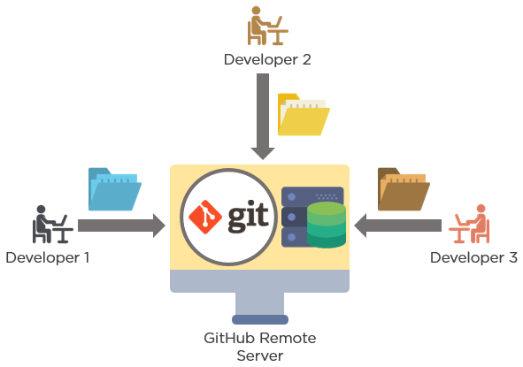
Difference between Git and GitHub
GitHub is a website where you can upload a copy of your Git repository.

Slide 5
Advantage of GitHub
Data redundancy and replication
High availability
Collaboration friendly
Track changes in your code across versions

Slide 6
Things to done in GitHub website
Create organization (FAST-VERTICA)
Create Remote Repository (or) Create new project (FAST)
Adding members in Git-Hub organization

Slide 7
Things to done in Linux Machine
Install Git on Linux
Initialize FAST folder as local repository and do initial COMMIT
Install and start openssh-server service
Generate and add SSH Public key in the git-hub website
Configure Git on Linux (Adding Remote Repository Details in Linux machine)
push the files of local Repository into remote repository

